Slide 1

Techniques to be used in the back-end
Flask
Numpy & Pandas

Slide 2

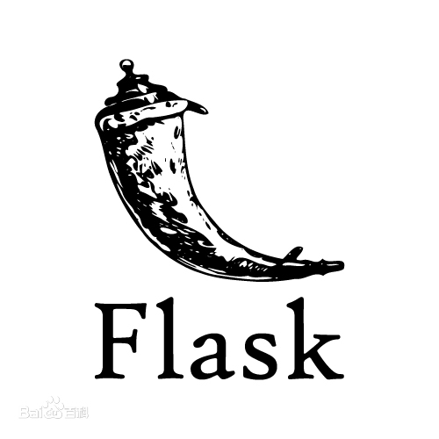
01
What is flask?
Flask is also called "microframe" because it uses a simple core and uses extension to add other functions. Flask has no default database and form verification tools.
It can be well combined with MVC mode for development, developers work together, small teams can complete the implementation of small and medium-sized websites or web services with rich functions in a short time. In addition, flask also has a strong customization, users can add corresponding functions according to their own needs, while keeping the core functions simple, realize the enrichment and expansion of functions, and its powerful plug-in library can enable users to realize personalized website customization and develop a powerful website.
Flask is a lightweight web application framework written in Python.

Slide 3
Machine Learning
(Jupyter Notebook)
Pandas
Numpy

Slide 4
02
Machine Learning
Why Flask?
How to train
In the follow-up research based on machine learning, the main development language is python. The unified development language of the whole system is convenient for development and later maintenance.
Jupyter notebook is a web-based application for interactive computing. It can be applied to the whole process of Computing: development, documentation, running code and displaying results.
What’s Numpy
What’s Panda
Numpy is a numerical calculation extension of python, which is specially used to deal with matrix, and its operation efficiency is more efficient than list.
Panda is a data analysis tool based on numpy, which can operate large data sets more conveniently.
PROJECT
PLAN
2030

Slide 5
